Slide 1

MLB Home run analysis
How do home runs contribute to wins in baseball?
Trent McNabb
Scott stimpson

Slide 2
Questions
How do Home Runs contribute to a team’s total wins for a season?
Began with 2015 – 2019 data and added 2010 – 2014 to increases the sample size.
What impact do Total Runs and Total Home Runs have on the correlation between Home Runs and Wins?
What impact do Home Run to Total Run Ratio have on the correlation between Home Runs and Wins?

Slide 3

The Game
30 Teams
162 Games per Season
Season-Games-Innings-At Bats
Offense = Batting/Hitting, Defense = Pitching/Fielding
Base running
Scoring

Slide 4
The Data
Source:
2010-2019 Major League Baseball Batting Statistics from https://www.Baseball-Reference.com
2010-2019 Major League Baseball Standings from https://www.Baseball-Reference.com
Collecting and Cleaning:
CSV files for each table on Baseball-Reference.com were easily downloaded.
2020 and 2021 we excluded for analysis because of the effect of the pandemic on the seasons.
Using a for loop to create data frames using each csv file as well as perform the regression analysis each year’s data sets.

Slide 5
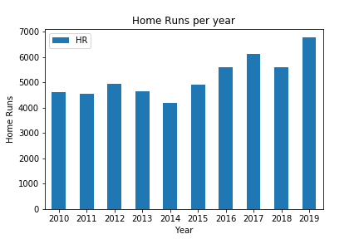
Homerun per Year 2010-2019
From 2010 to 2015 the home runs hit each season remained relatively constant. After 2015 the number of home runs was greater than the last with the exception being 2018. 2019 ended with the most home runs ever hit in a single MLB season.

Slide 6
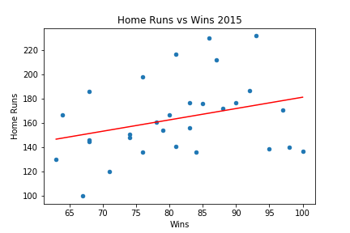
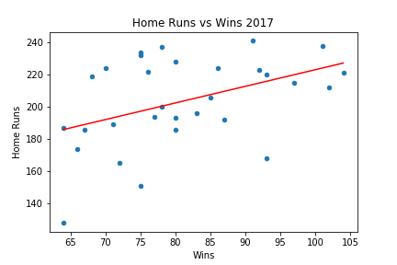
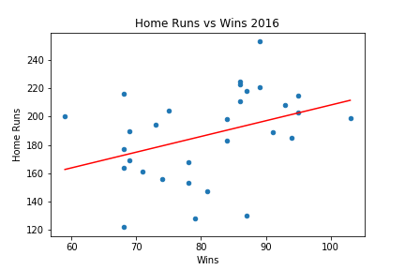
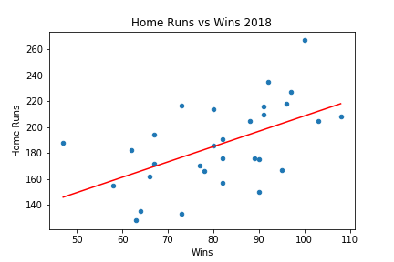
2015-2018 Home Run vs Wins
2018
Wins vs HR Correlation: 0.541
Total Runs: 21630
Home Runs: 5585
HR to total run ratio:0.258
2017
Wins vs HR Correlation: 0.43
Total Runs: 22582
Home Runs: 6105
HR to total run ratio:0.27
2016
Wins vs HR Correlation: 0.371
Total Runs: 21744
Home Runs: 5610
HR to total run ratio:0.258
2015
Wins vs HR Correlation: 0.307
Total Runs: 20647
Home Runs: 4909
HR to total run ratio:0.238

Slide 7
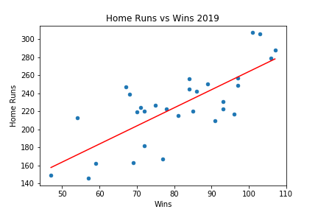
2019 Home runs vs wins
Wins vs HR Correlation: 0.764
Total Runs: 23467
Home Runs: 6776

Slide 8
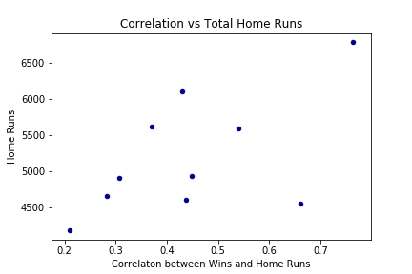
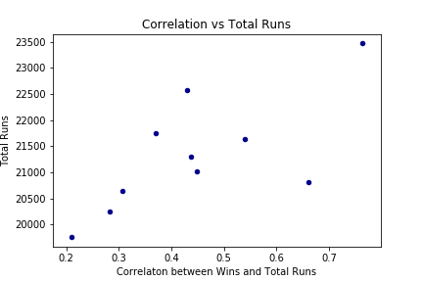
Hr/wins vs total hr & runs

Slide 9
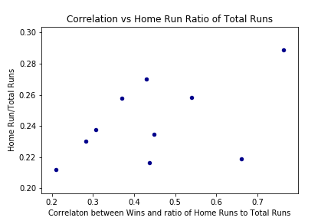
Hr/wins vs Hr-run ratio

Slide 10
Conclusions
The most home runs ever hit in a single MLB season occurred in 2019.
MLB batting statistics between 2017 – 2019 indicated and anomaly, particularly in homeruns and the correlation to total wins.
As more home runs are hit, the less likely they are to influence the outcome of a game which leaves us to believe there are other influencing variables.
Further investigation would require analysis of other aspects in baseball like pitching or equipment changes. Retrieving data related to the runs generated by each home run which can vary between (1 and 4 runs).

Slide 11
Appendix
Sports Illustrated. “Did MLB Use Juiced Balls in 2020?” https://www.si.com/mlb/2021/02/09/mlb-ball-is-live-daily-cover
Baseball-Reference.com. https://www.baseball-reference.com/leagues/majors.shtml

